Slide 1
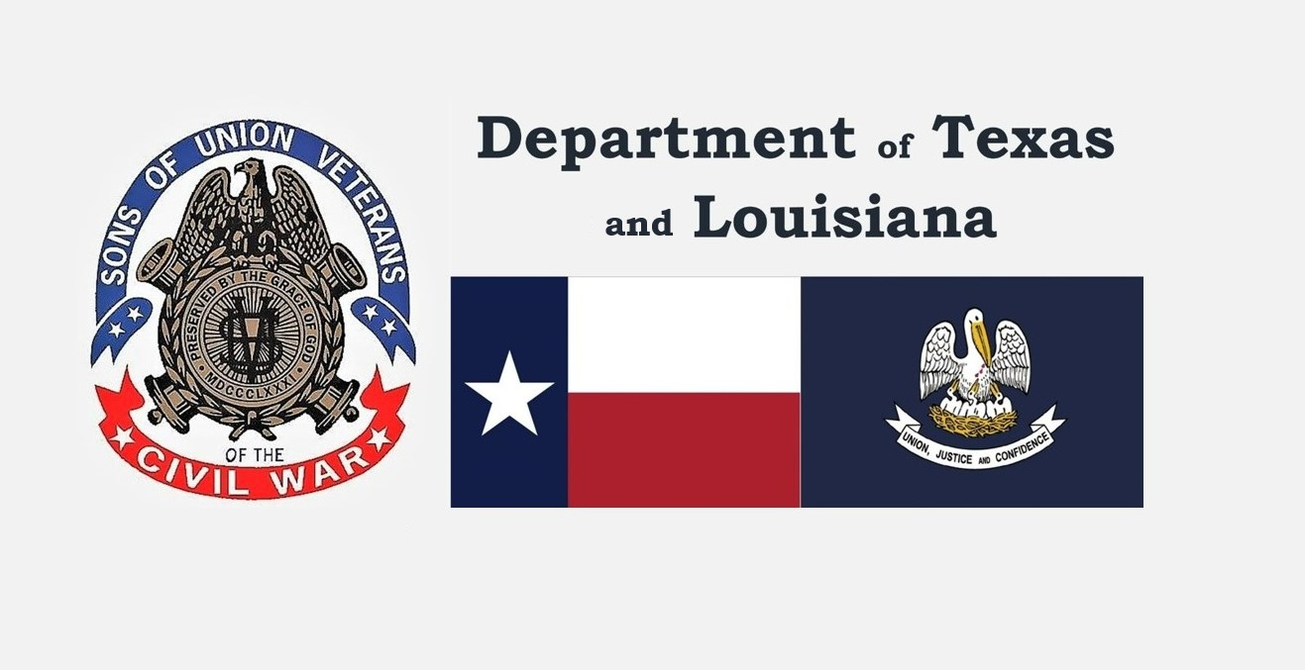
Want to learn more about the Sons of Union Veterans of the Civil War? Visit our website at txsuv.org or scan the QR code below

Slide 2
The Sons of Union Veterans of the Civil War (SUVCW) is a fraternal organization dedicated to preserving the history and legacy of veteran heroes who fought and worked to save the Union in the American Civil War. Organized in 1881 and chartered by Congress in 1954, SUVCW is the legal heir and successor to the Grand Army of the Republic.

